Slide 1

ADVENTURE WORK CYCLE 2023-24

Slide 2

Introduction
Adventure Works Cycles, the company on which the Adventure Works Cycle databases are based, is a large, multinational manufacturing company. The company manufactures and sells metal and composite bicycles to North American, European and Asian commercial markets. While its base operation is in Bothell, Washington with 290 employees, several regional sales teams are located throughout their market base.

Slide 3

Module
EXCEL
Tableau
MySQL
Power BI

Slide 4
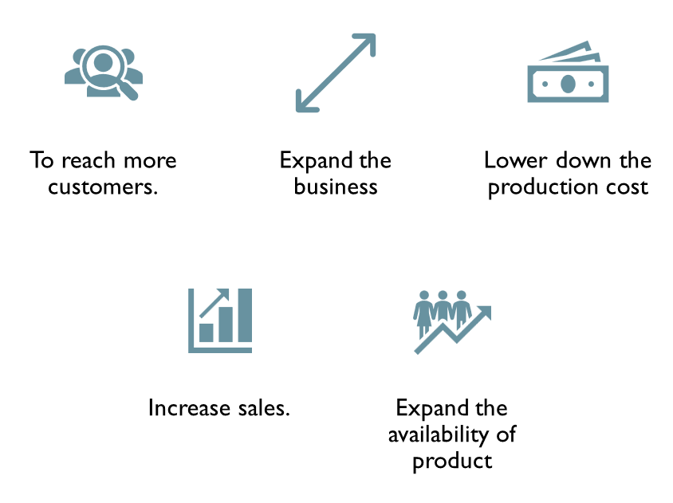
REQUIREMENT

Slide 5
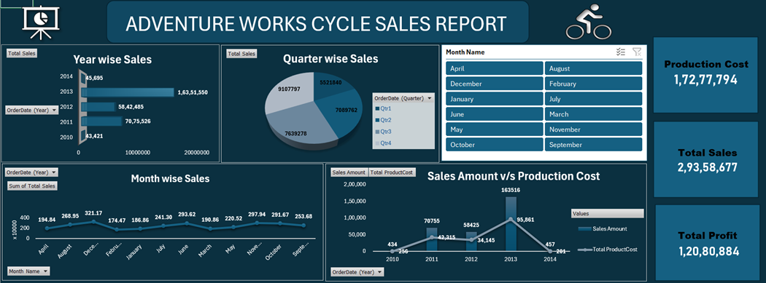
Sales Analysis

Slide 6
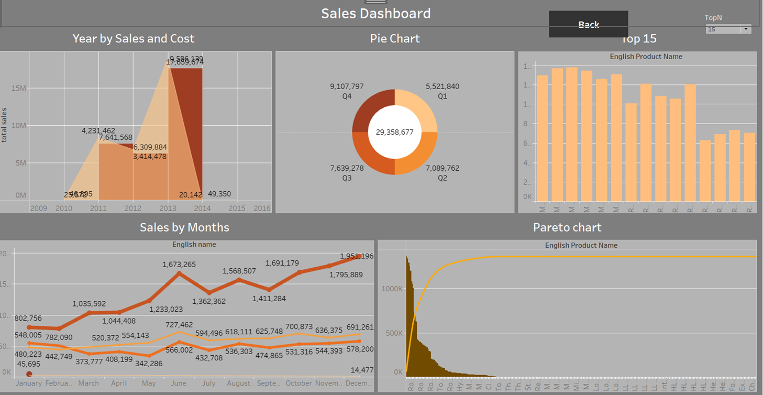

Slide 7
Problems Statements Lack of IT infrastructure to support timely reporting to various key business leaders & Information seekers. Ineffective Sales planning and forecasting. Undefined sales territory responsibilities due to poor information retrieval time and process. Poor stocking prediction by production department , lead to high manufacturing cost. Unable to calculate customer and profitability.

Slide 8
Solutions
Invest in upgrading IT infrastructure to support efficient data collection, analysis, and reporting.
Utilize advanced analytics and predictive modeling techniques to improve sales planning and forecasting accuracy.
Develop clear guidelines and processes for defining sales territories and responsibilities.
Analyze historical sales data and market trends to identify patterns and improve stocking predictions.
Regularly review and analyze customer profitability reports to identify opportunities for improvement and optimize resource allocation.

Slide 9
Thank you

